Slide 1

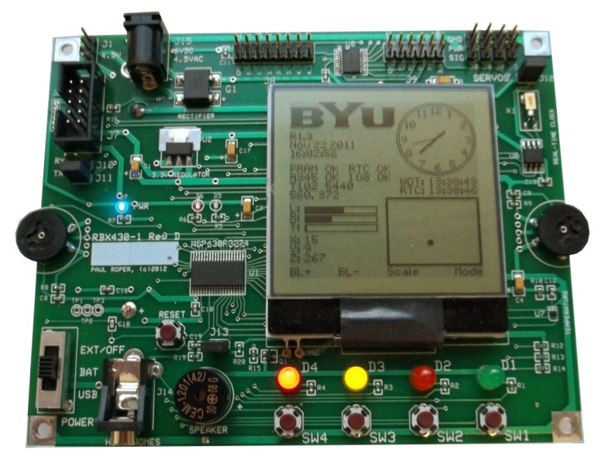
Lab 7b: Morse Code II
http://www.youtube.com/watch?v=fZKVdxeWsyw

Slide 2
Lab 7b: Morse Code II
"Use your Morse Code main assembly lab code to write a C program that outputs alphanumeric Morse code messages using an LED and a transducer (magnetic speaker). Use the watchdog as an interval timer whose interrupt service routine (ISR) pulse width modulates (PWM) the transducer device creating a tone. Use a C string to store the message. Use Switch #1 to toggle the tones on and off."

Slide 3
Morse Code II Lab
Use your Morse Code main assembly lab code to write a C program that outputs alphanumeric Morse code messages using an LED and a transducer (magnetic speaker).
Use the watchdog as an interval timer whose interrupt service routine (ISR) pulse width modulates (PWM) the transducer device creating a tone.
Use a C string to store the message.
Store all C and assembly equates in a C header file. Include the header file in both your C and assembly programs.
Assess Dot and Dash codes from an external assembly file.
Use Switch #1 to turn the tones on and off.

Slide 4
Learning Objectives
By completing the Morse Code Lab, a student will have:
Translated assembly language code to C.
Used a C header file for all assembly/C constants.
Interfaced C code with external functions including assembly and other C modules.
Demonstrated "callee-save" protocol when calling subroutines.
Linked symbolic values together from different program files.

Slide 5
C / Assembler Protocol
f(w,x,y,z)
Argument | < 32-bit Type | 32-bit Type | struct/union
4th (z) | R15 | On the stack | On the stack
3rd (y) | R14 | On the stack | On the stack
2nd (x) | R13 | R15:R14 | On the stack
1st (w) | R12 | R13:R12 | On the stack
Return Value | R12 | R13:R12 | Special Area
Arguments are evaluated right to left:
if 8 or 16-bit data types, w, x, y, and z are passed to the function in registers r12, r13, r14, r15 respectively.
If 32-bit data types, z is pushed onto the stack, followed by y, followed by w and x in registers pairs r13:r12 and r15:r14 respectively.
The result is returned in R12 (or R13:R12 for a 32 bit type) or in a special area pointed to by R12 if it is a struct or union type.

Slide 6
C / Assembler Protocol
C
Assembly
extern int asm_mult(int, int);
void main(void)
{
int result;
result = asm_mult(10, 20);
return;
}
int C_multiply(int x, int y)
{
return x * y;
}
.def asm_mult
.ref C_multiply
.text
; asm_mult ********************
; IN: r12 = arg1
; r13 = arg2
; OUT: r12 = arg1 * arg2
;
asm_mult:
call #C_multiply
ret
.end
extern must be used to declare C function prototype

Slide 7
C / Assembler Protocol
C
Assembly
extern int asm_mult(int, int);
void main(void)
{
int result;
result = asm_mult(10, 20);
return;
}
int C_multiply(int x, int y)
{
return x * y;
}
.def asm_mult
.ref C_multiply
.text
; asm_mult ********************
; IN: r12 = arg1
; r13 = arg2
; OUT: r12 = arg1 * arg2
;
asm_mult:
call #C_multiply
ret
.end
All C functions are externally defined
(unless declared static)

Slide 8
volatile
volatile proceeding a variable name instructs the compiler to
prohibit caching the variable’s contents when optimizing code.
always re-read the variable’s value when accessing the variable.
not use computer registers to store a variable’s content.
volatile int switches,dcnt
void main(void)
{
if (switches & 0x01) {...}
}
#pragma vector=PORT1_VECTOR
__interrupt void Port_1_ISR(void)
{ P1IFG &= ~0x0f; // P1.0-3 IFG cleared
dcnt = DEBOUNCE_CNT; // enable debounce
}
#pragma vector = WDT_VECTOR
__interrupt void WDT_ISR(void)
{ if (dcnt && (--dcnt == 0)) switches = (P1IN ^ 0x0f) & 0x0f;
}
Pressing a switch sets dcnt
Inform the compiler that integers switches and dcnt are not to be optimized.
Sample P1IN when dcnt equals 0

Slide 9
Part 1 – Setup
Create an empty CCS Morse2 C project.
Rename main.c to morse2.c, add your Morse Code Lab assembly files (morse.asm, morse_codes.asm), and a C header file (morse2.h) to your Morse2 project.
Modify your morse2.c to call main_asm in morse.asm file.
Replace the main function in morse2.c file with the following code:
extern int main_asm(void);
int main(void)
{
WDTCTL = WDTPW | WDTHOLD;
main_asm();
return 0;
}

Slide 10
Part 1 – Setup
Add (temporarily) the following assembly code to your morse.asm file:
Find and delete (or comment) the following assembly code from your morse.asm file:
Compile and execute. Verify your Morse Code II lab works.
.def main_asm
; power-up reset --------------------------------------
RESET: mov.w #STACK,SP ; initialize stack pointer
call #main_asm ; call main function
jmp $ ; you should never get here!
.sect ".reset"
.word RESET ; RESET ISR

Slide 11
Part 2 – The Lab
Replace the contents of your C main function with cut assembly code from your morse.asm file.
Replace:
with the cut main_asm assembly code from your morse.asm file:
Comment all lines of assembly code (using contrl-/).
main_asm();
; start main function vvvvvvvvvvvvvvvvvvvvvvvvvvvvvvv
.def main_asm
main_asm: mov.w #WDT_CTL,&WDTCTL ; set WDT interval
mov.b #WDTIE,&IE1 ; enable WDT int
...
jmp loop ; repeat
; end main function ^^^^^^^^^^^^^^^^^^^^^^^^^^^^^^^^^

Slide 12
Part 2 – The Lab (continued)
Move all #define's and assembly .equ's to morse2.h. Include morse2.h in both morse2.c and morse.asm files.
Translate all assembly .equ's to C #define's and include in morse2.h.
Do not put any variable or function definitions (code) in your header file!
Be careful to parenthesize all constant calculations. (ie, Use "#define ELEMENT (XXX * 10) / 100" instead of "#define ELEMENT XXX * 10 / 100", which evaluates to zero.)
Include morse2.h in your C files:
Include morse2.h in your assembly files:
#include "msp430.h" // .cdecls C,"msp430.h"
#include "morse2.h"
#include <stdlib.h>
#include <ctype.h>
.cdecls C,"msp430.h"
.cdecls C,"morse2.h"

Slide 13
Part 2 – The Lab (continued)
Add C code to your main function that implements the commented assembly code.
Where possible, place the C code on the same line as the assembly code.
Remember, MSP430 registers are just variables.
Multiple assembly lines may be represented by one C statement.
All assembly functions called from C must follow C register usage and be callee-safe.
extern char* letters[]; // ; start main function vvvvvvvvvvvvvvvv
// .def main_asm
int main(void) // main_asm:
{
WDTCTL = WDT_CTL; // mov.w #WDT_CTL,&WDTCTL ; WDT config
WDTSecCnt = WDT_IPS; // mov.w #WDT_IPS,WDTSecCnt ; 1s counter
IE1 = WDTIE; // mov.b #WDTIE,&IE1 ; WDT ints
P3DIR = 0x10; // bis.b #0x10,&P3DIR
while (1) // loop:
{ char c;
char* cptr;
char* mptr = message; // mov.w #message,r4 ; message
while (c = *mptr++) // loop2:
{ // mov.b @r4+,r5 ; get char
// cmp.b #0,r5 ; done?
// jeq loop10 ; y

Slide 14
Part 2 – The Lab (continued)
Use .ref and extern to cross reference variables.
To reference assembly variables from C, use extern and .def:
Assembly C
To reference C variables from assembly code, use .ref:
C Assembly
.def beep_cnt
.bss beep_cnt,2
extern int beep_cnt;
beep_cnt = 100;
int beep_cnt;
beep_cnt = 100;
.ref beep_cnt;
mov.w #100,beep_cnt

Slide 15
Part 2 – The Lab (continued)
Repeat the process of cutting, pasting, and translating an assembly ISR into your morse2.c file.
Call at least one assembly function using correct C calling convention. Modify function (if necessary) such that it is callee-safe.
extern volatile int dcnt; // .def dcnt
// .bss dcnt,2 ; debounce counter
#pragma vector=PORT1_VECTOR
__interrupt void Port_1_ISR(void)
{ // P1_ISR:
P1IFG &= ~0x0f; // bic.b #0x0f,&P1IFG ; acknowledge
dcnt = DB_CNT; // mov.w #DB_CNT,&dcnt ; reset counter
return; // reti
}

Slide 16
How Assembler Relates to C

Slide 17
if-then-else
if-then-else
cmp.w #1,buzzerON ;
jne myElse ;
xor.b #0x20,&P4OUT ;
bis.b #0x02,&P1OUT ;
jmp myNext ;
myElse: ;
bic.b #0x02,&P1OUT ;
;
myNext: ;
if (buzzerON == 1)
{
pulse_buzzer();
turn_on_LED();
}
else
{
turn_off_LED();
}

Slide 18
switch / case
switch / case
cmp.w #DOT,myByte ;
jne sw_01 ;
call #do_dot ;
jmp sw_end ;
sw_01:
cmp.w #DASH,myByte ;
jne default ;
call #do_dash ;
jmp sw_end ;
;
default: ;
sw_end: ;
switch (myByte)
{
case DOT:
do_dot();
break;
case DASH:
do_dash();
break;
default:
}

Slide 19
for-loop
for-loop
.bss i,2 ;
mov.w #0,i ;
for_ck: cmp.w #10,i ;
jge for_done ;
call #do_dot ;
call #delay ;
call #do_dash ;
call #delay ;
add.w #1,i ;
jmp for_ck ;
for_done: ;
int i;
for(i=0; i<10; i++)
{
do_dot();
delay();
do_dash();
delay();
}

Slide 20
while
while loop…
TRUE .equ 1
.bss blink,2 ;
mov.w #TRUE,blink ;
while_loop: ;
cmp.w #0,blink ;
jeq while_done ;
call #LED_ON ;
call #delay ;
call #LED_OFF ;
call #delay ;
jmp while_loop ;
while_done: ;
#define TRUE 1
int blink = TRUE;
while (blink)
{
LED_ON();
delay();
LED_OFF();
delay();
}

Slide 21
Morse Code II Requirements
Morse Code
1 point | Your Morse II Lab includes C and assembly code, and contains header comments stating your name and a declaration that the completed assignment is your own work.
2 points | Your Morse Code "main" function and at least one ISR are written in C. At least one assembly function is called from C using correct C calling convention and is callee-safe.
1 point | Assembly arrays numbers and letters in morse_codes.asm are correctly referenced in your C program as character pointer arrays.
2 points | A C header file containing all C #define's and assembly equates(.equ's changed to #define's) is included in all .c and .asm files. NO VARIABLE OR FUNCTION DEFINITIONS ARE FOUND IN THE HEADER FILE (ie, only declarations, pre-processor commands, and function prototypes).
2 points | Your commented assembly code appears to the right of the C statements. (Small blocks of assembly code are acceptable. See example above.)
2 points | Your C Morse Code II machine meets all the same requirements as the assembly Morse Code lab.

Slide 22
Morse Code II Requirements
Morse Code
Bonus Points:
+1 point | Passed off with a TA at least one day early. (No timestamps please!)
+2 points | The current character, message, and speed are displayed in real-time on the LCD.
+1 point† | The MSP430 enters low power mode 0 while the watchdog ISR outputs DOTs, DASHes, and space elements.
+2 points† | Using interrupts, pressing Switch #2 (SW2) decreases the output speed of your Morse Code Machine by 1 word per minute. Pressing Switch #3 (SW3) increases the speed of your machine by 1 word per minute. The output speed is displayed in the LEDs (D1-D4). Do the calculations in the switch and watchdog ISRs.
-1 points | For each school day late. (Timestamps may be used to verify completion time.)
 | †Only awarded if not used for bonus credit in the Morse Lab.

Slide 23
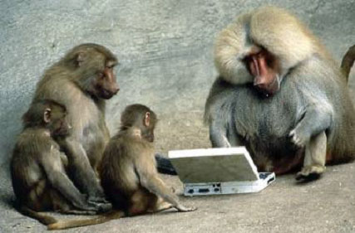

Slide 24
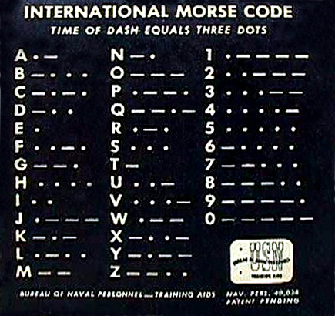
Morse Code
Morse Code
The word PARIS is the standard to determine Morse Code speed.
Each dit (dot) is one element,
Each dah (dash) is three elements,
Intra-character spacing is one element,
Inter-character spacing is three elements,
and inter-word spacing is seven elements.
PARIS is exactly 50 elements
If you send PARIS 5 times in a minute (5 WPM) you have sent 250 elements.
250 elements into 60 seconds per minute = 240 milliseconds per element.
13 words-per-minute is one element every 92.31 milliseconds.
•••• • • •• • •• • • • • •• ••

Slide 25
Part 1 – Setup
Create an empty CCS Morse2 C project.
Rename main.c to morse2.c, add Morse Code Lab assembly files, and a C header file to your Morse2 project.
Modify your morse2.c to call main_asm in morse.asm file.
Replace the main function in morse2.c file with the following code:
Add (temporarily) the following assembly code to your morse.asm file:
Delete the following assembly code from your morse.asm file:
Compile and execute. Verify your Morse Code II lab works.
extern int main_asm(void);
int main(void) {
WDTCTL = WDTPW | WDTHOLD;
main_asm();
return 0;
}
.def main_asm
.sect ".reset“
.word RESET ; RESET ISR

